Slide 1


Slide 2
Price Prediction Project
QL2 Software LLC

Slide 3







Team Members
Sukriti Bharti
Project Manager
MISM
Shruti Karandikar
Finance Manager
MISM
Raghav Sood
Data Analyst
MISM
Prof. Beibei Li
Project Advisor
Yuhan He
Data Analyst
MISM
Jiabin Chen
Data Analyst
MISM
Bramantyo Danur Jati
Data Analyst
MISM

Slide 4
Agenda
Context Setting and Approach
Data and Exploratory Analysis
Regression and Results
Data Transformations
Baseline Classification
Classification on Merged Data
Inferences and Prospective Future Work
Challenges
Meeting Schedules & Interactions
Q/A

Slide 5

Our Client
Harvests, curates, analyzes and sells the best travel related industry data
Maintains a large data repository with advanced request analytics
Helps clients improve market position with quick comprehensive and competitive insights

Slide 6
Problem Statement
Our client hypothesizes that the price trends in airline and car rental industries are interconnected. Without substantiating this, their analysis is limited to within a given industry.
Purpose
Validate client’s hypothesis and quantify any relationship between the two industries, justified with data

Slide 7
Objectives
Understand the relationship between Airfare data and Car Rental Data
Build a classification model so that we can predict the increase or decrease in car rental price based on the airline price.

Slide 8
Business Impact
How will this benefit QL2 and their clients?
Beginning of establishing broader travel trends across multiple verticals
Enable clients to identify potential changes in travel demand far earlier
Potentially allow clients to adjust their pricing and inventory decisions

Slide 9
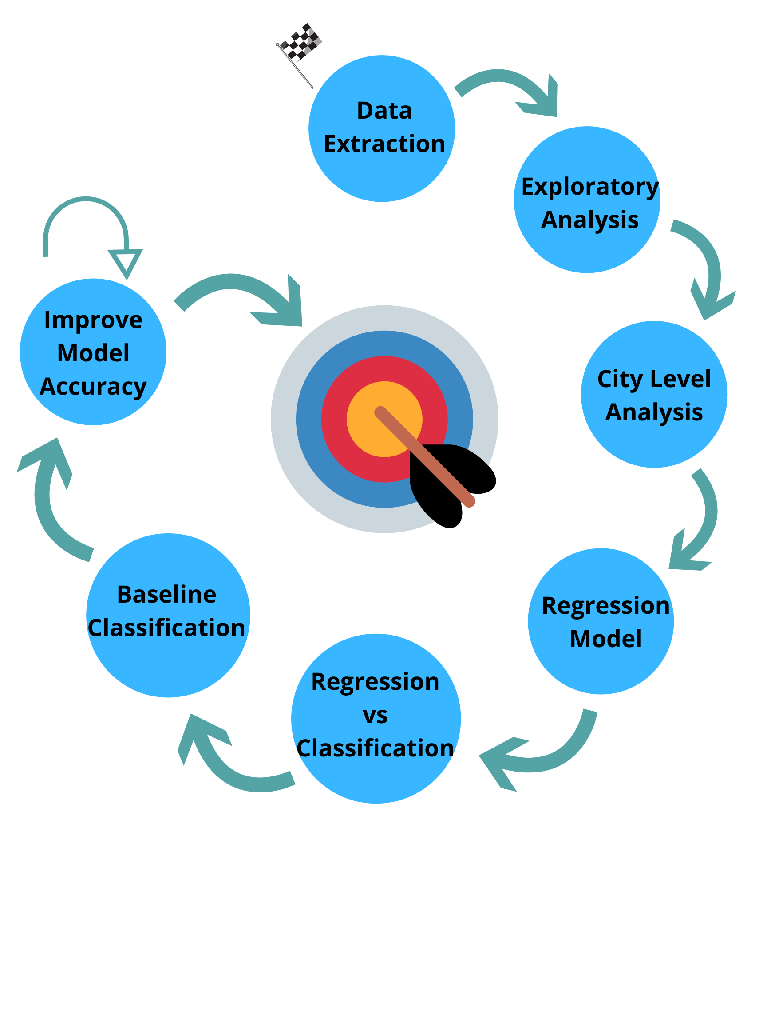
Approach

Slide 10
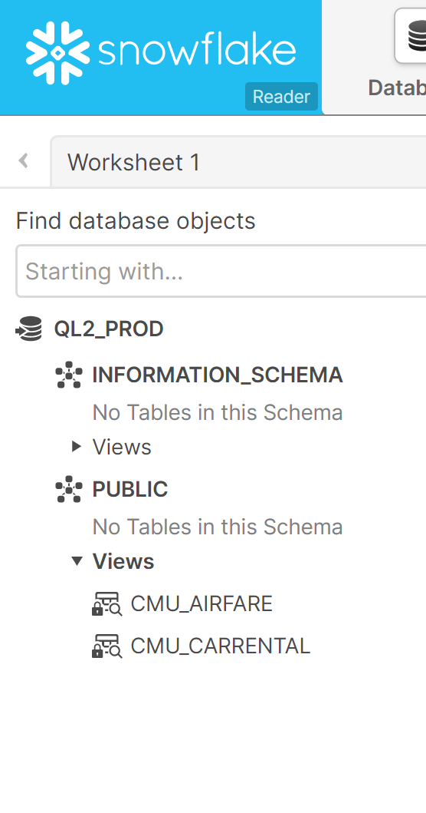
Snowflake Instance
Airfare Columns:
Departure and Arrival airports (161)
Airline Carrier (7)
Departure Date (2018, 2019, 2020)
Departure Time
Fare
Total Rows: Approx. 92 million
Car Rental Columns:
Location (25)
Agencies (8)
Types of Cars (32)
Outsipp (60)
Pickup and Drop Dates (2018, 2019, 2020)
Daily Fare
Total Rows: Approx. 8.5 billion

Slide 11
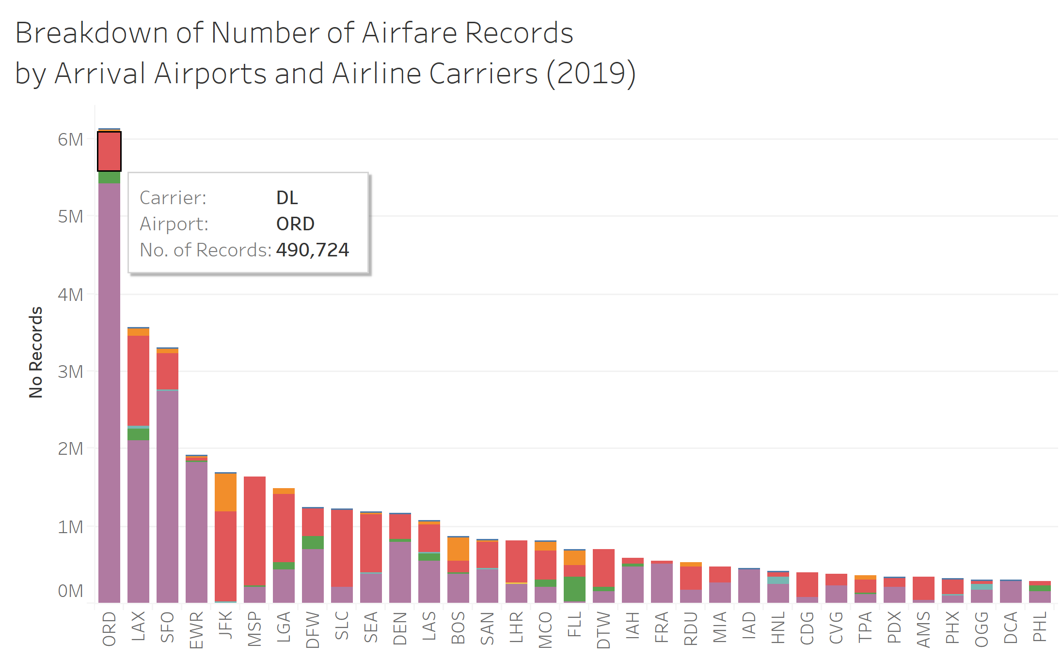
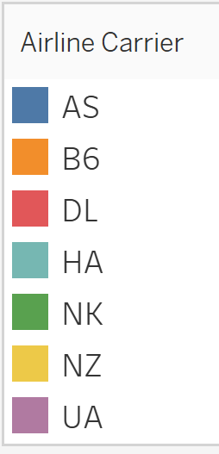
Airfare Data
Arrival Airport

Slide 12
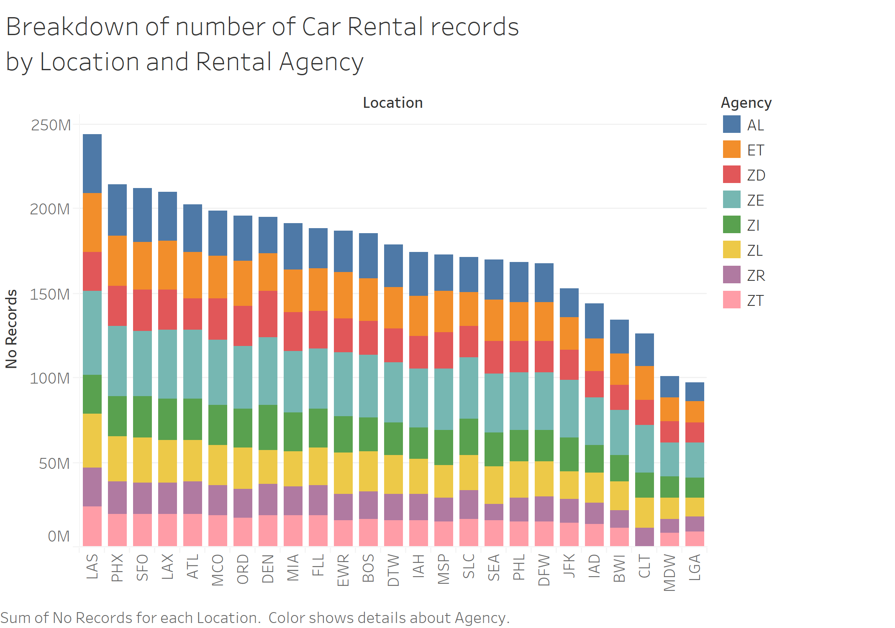
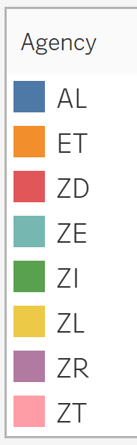
Car Rental Data

Slide 13
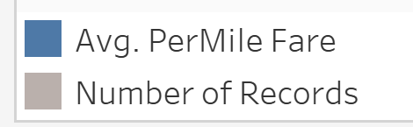
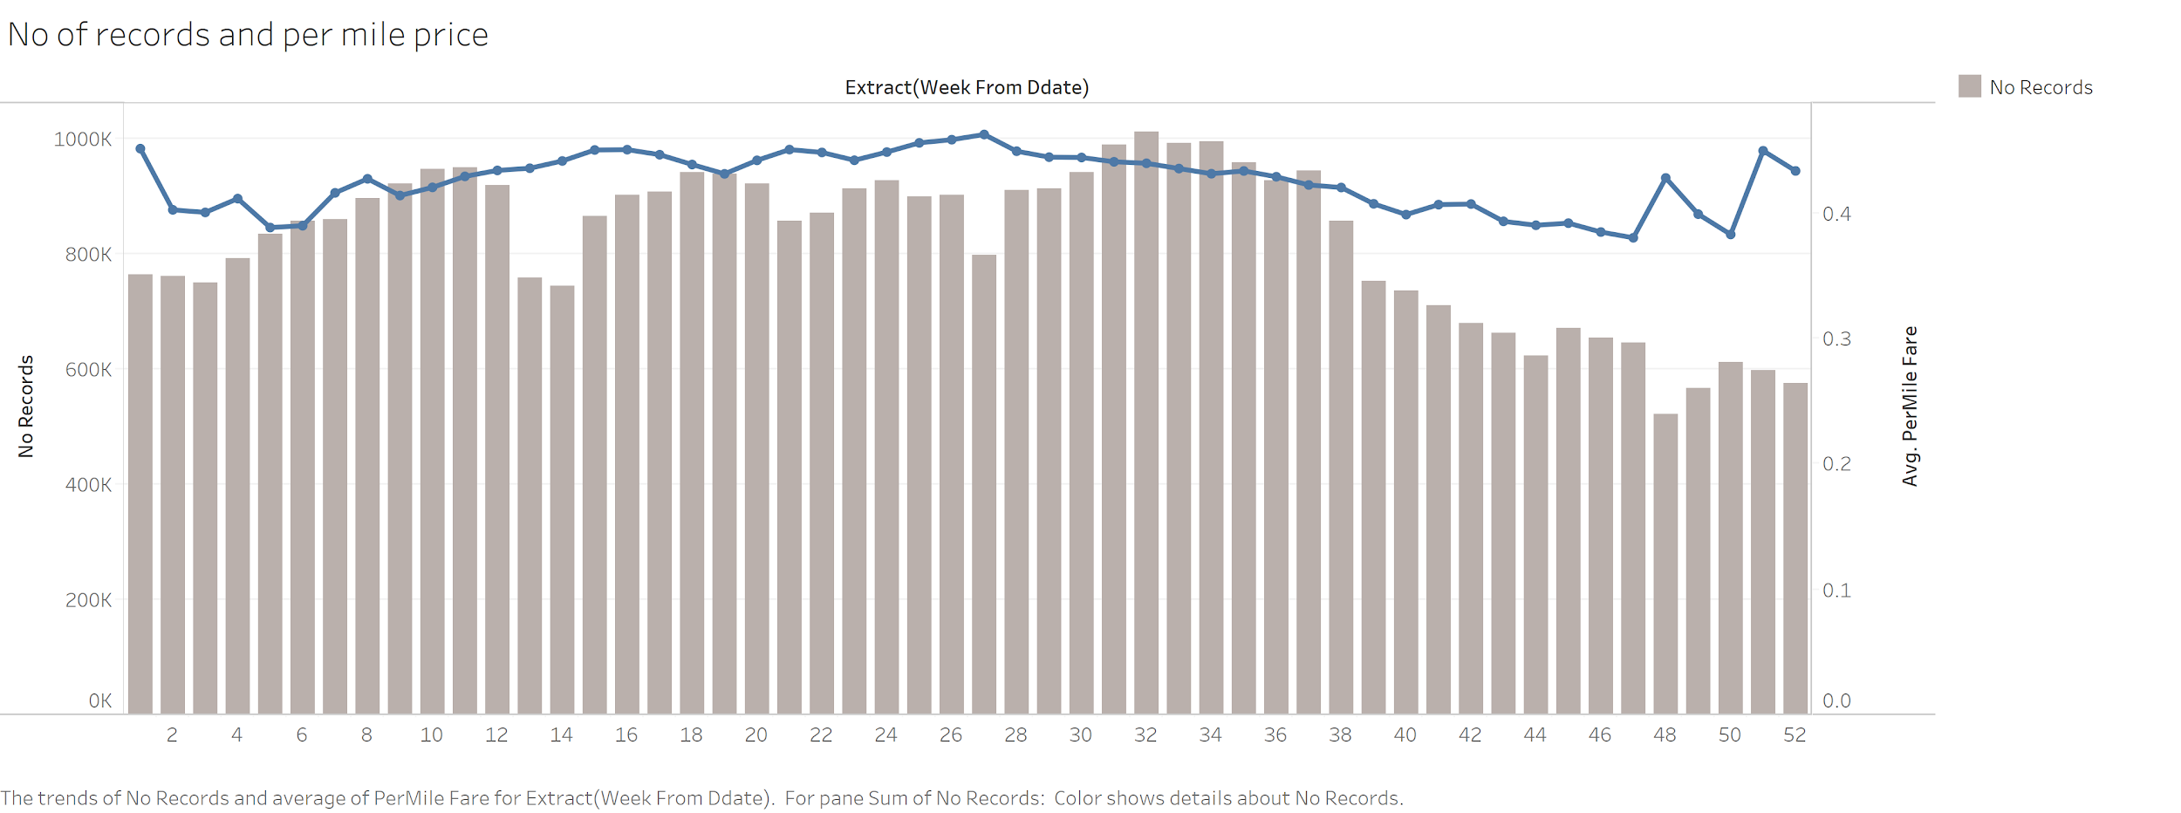
No. of Records and Average Airfare per Mile

Slide 14
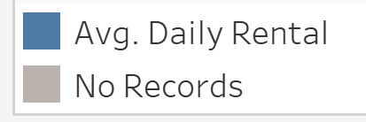
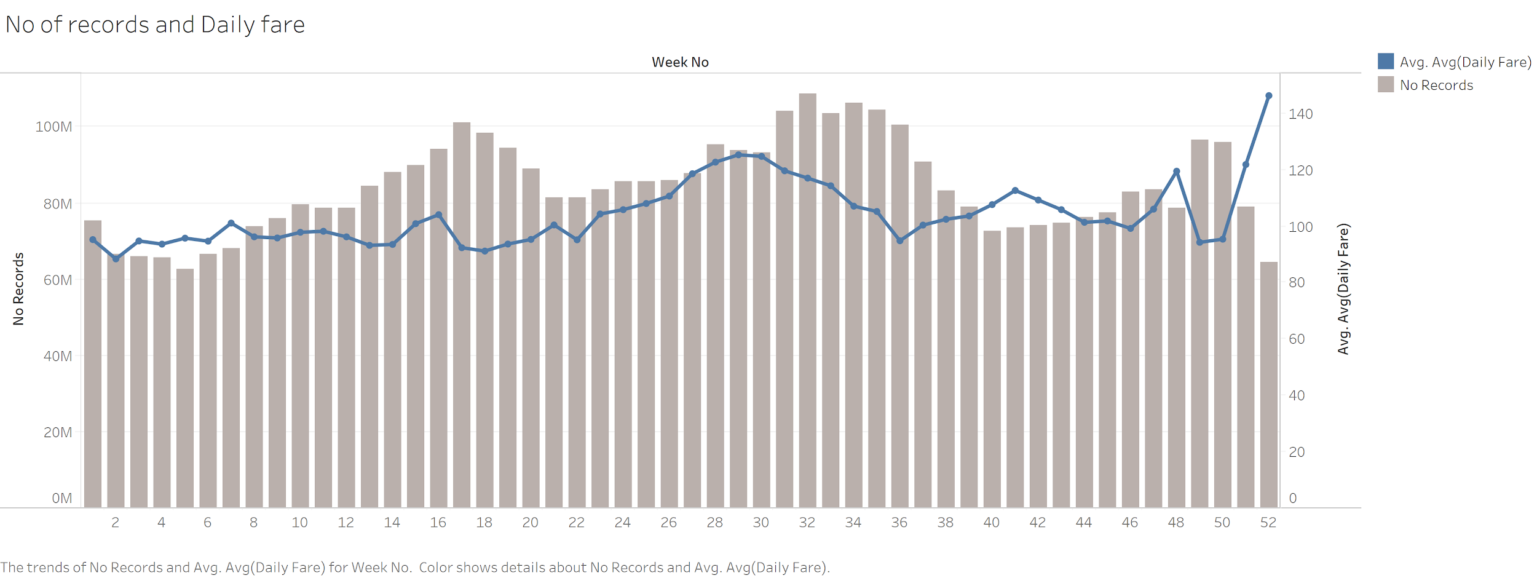
No. of Records and Average Daily Car Rental

Slide 15
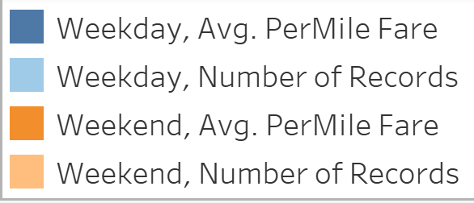
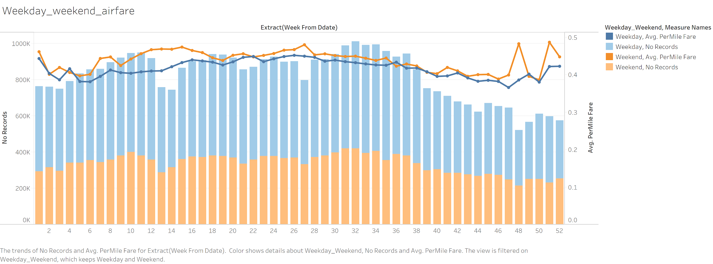
Weekday and Weekend Trends in Average Airfare per Mile

Slide 16
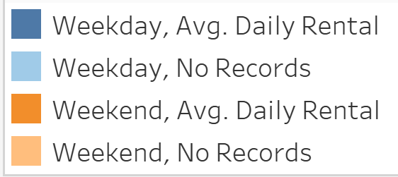
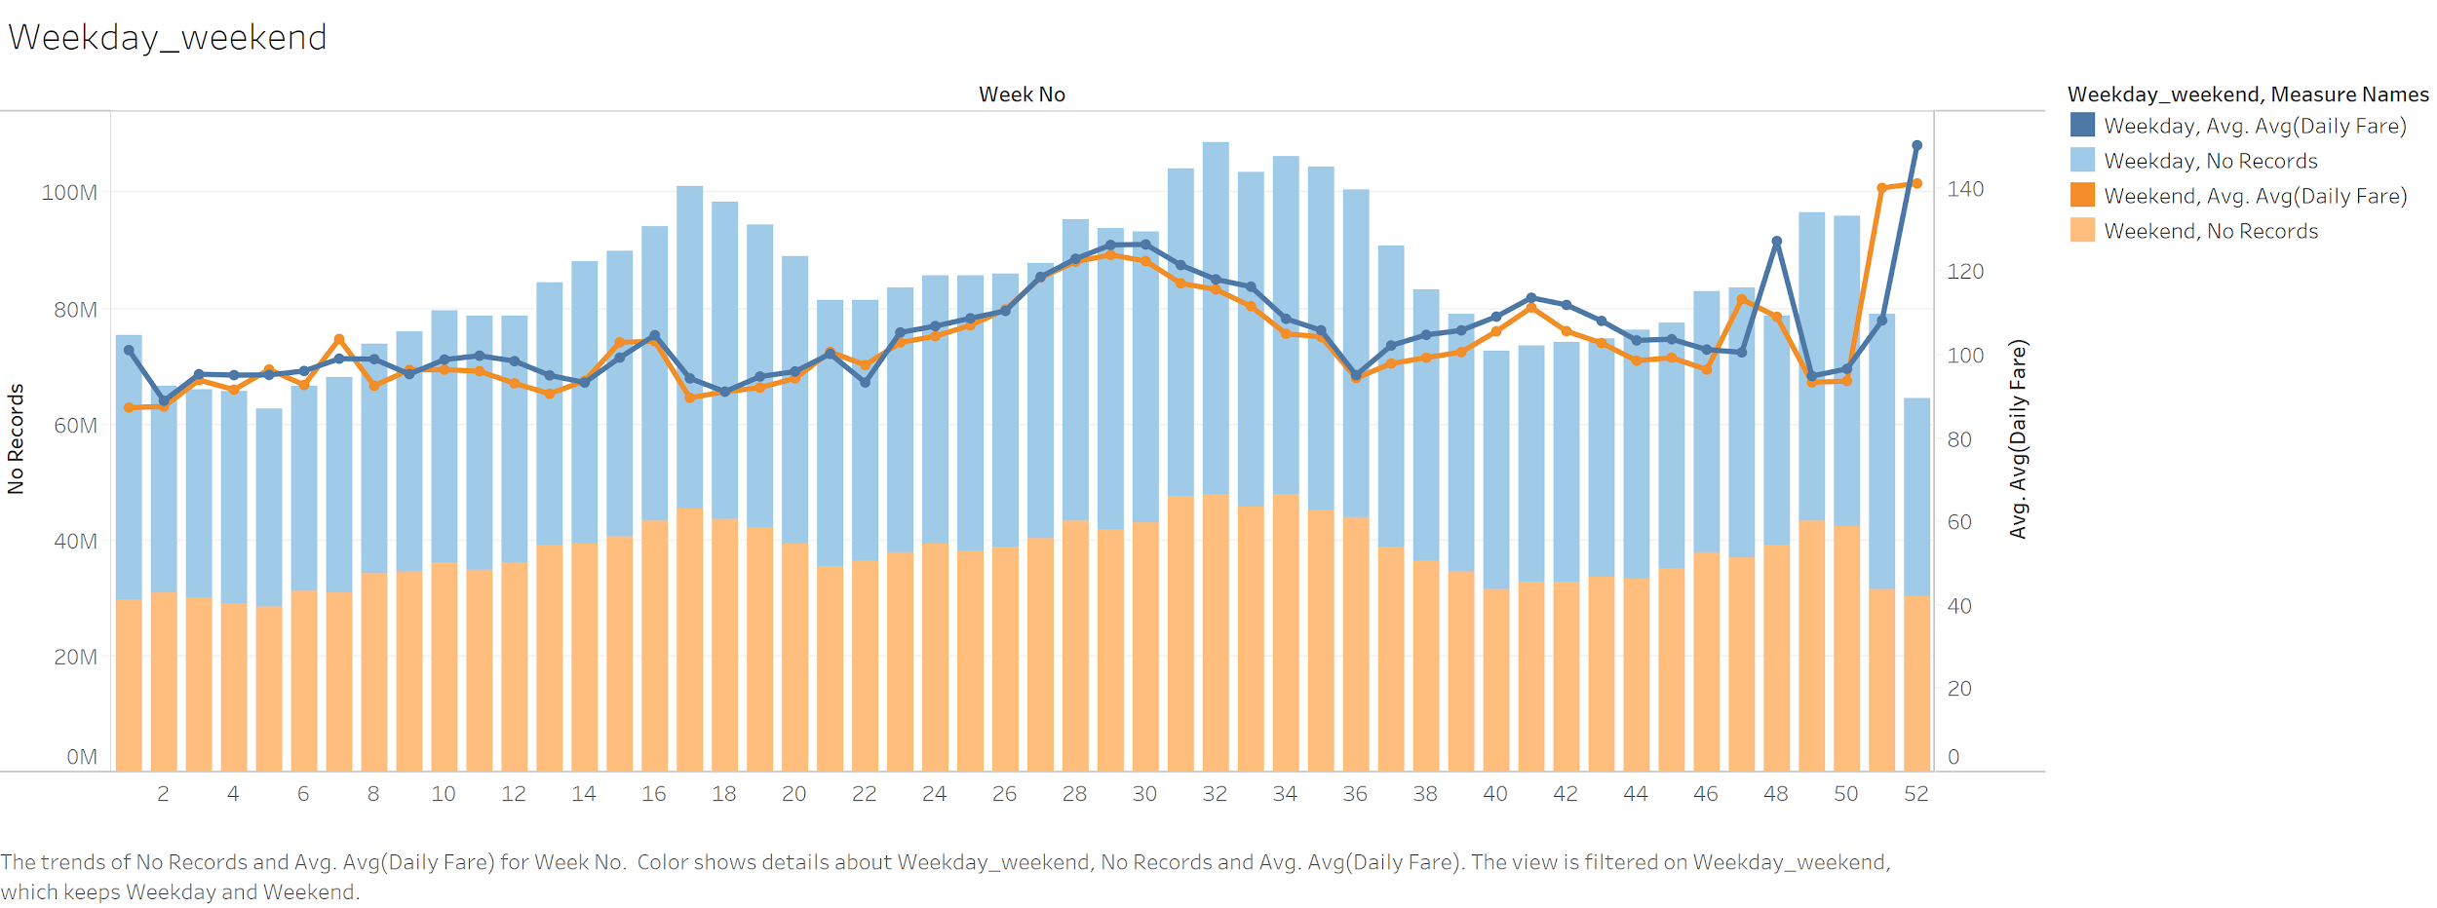
Weekday and Weekend Trends in Average Daily Car Rental Fare

Slide 17
So far..
6th March, 2020

Slide 18
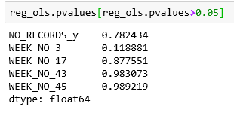
Linear Regression
Features on merged dataset :
Agency -> one hot encoding
week_no -> one hot encoding
weekend -> 0/1 depends on the pickup date
no_of_records_x -> Number of flights arriving at LAX
no_of_records_y -> Number of cars rented at LAX
avg_daily_fare -> target dependent variable
Results
No_of_records_y (number of cars rented at LAX) turned out to be insignificant

Slide 19
Regression vs Classification
Feedback after mid-term to use classification :
Create label for classification :
Increase in Price
Decrease in Price
No Change in Price
Create baseline model using car data only.
Create merged model by adding airfare data to baseline.
Evaluate Accuracy, Precision, and Recall.

Slide 20
So far..
6th March, 2020
25th March, 2020

Slide 21

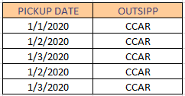

Car Rental: Distribute Fare on LOR
Expand
Aggregate on COLLECT DATE, PICKUP DATE and OUTSIPP to get
AVERAGE FARE
MIN FARE
MAX FARE
MEDIAN FARE

Slide 22
Car Rental: Outsipp and Holiday
Car type -> Outsipp (60) -> Category (5)
Premium, Luxury, Midrange, Economy, Basic
E.g. Full size SUV -> CCAR -> Midrange
Pick up date -> holiday, holiday before, holiday after, weekend
Pick-up Date |  | Holiday | One Day Before Holiday | One Day After Holiday | Weekend
01-01-2019 |  | 1 | 0 | 0 | 0

Slide 23
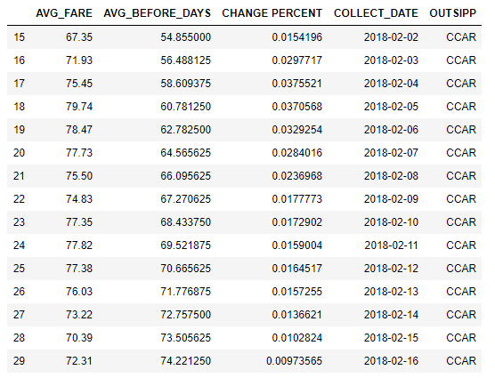
Car Rental: Moving Average and Change Percent
Moving Average: 15 days average, for same Outsipp
Change Percent: % change based on Moving Average

Slide 24
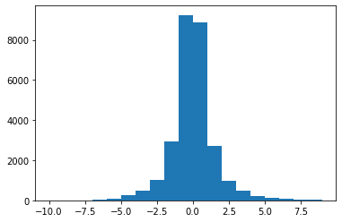
Car Rental: Increase/Decrease/No change
Multiclass classification labels: increase/decrease/no change
Histogram of Change Percent
Threshold (change percent):
Mean ± 0.25 * Standard Deviation
Percentage for three labels:
Increase: 29%
Decrease: 31%
No Change: 40%

Slide 25
Baseline Model - Random Forest on Car Data Only
Percentage in testing data:
Increase: 24%
Decrease: 32%
No Change: 44%
Accuracy on testing data
41.47%
 | Precision | Recall | F1-score
Decrease | 0.53 | 0.29 | 0.38
Increase | 0.28 | 0.58 | 0.38
No change | 0.55 | 0.41 | 0.47
Test Classification report

Slide 26
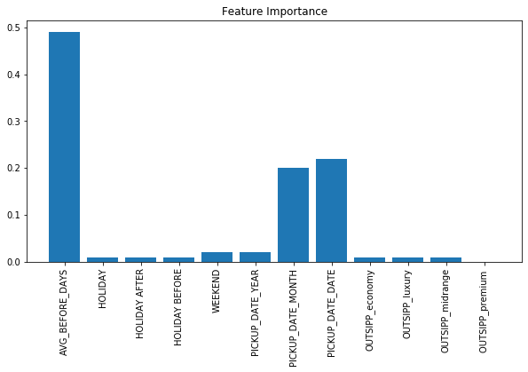
Baseline Model - Random Forest on Car Data Only
Important Features:
AVG_BEFORE_DAYS (Moving Avg)
PICKUP_DATE_DATE
PICKUP_DATE_MONTH

Slide 27
So far..
15th April, 2020
6th March, 2020
25th March, 2020

Slide 28
Transformation of Data: Airfare
Original:
Date Features : COLLECT_DATE, QL2_QTS, DDATE, DTIME
Demographic Features : FROM_AIRPORT, TO_AIRPORT , SITE , CXR
Flight Features : DSTP, CURRENCY, DFLIGHT, DROUTE , FARE
Aggregations:
Single day granularity and not time - Removed COLLECT_DATE,DTIME
Market level data - Removed CXR, SITE
Price per mile - Removed the bias for distance, FROM_AIRPORT
Aggregated 9,149,465 records to 69,094 records

Slide 29
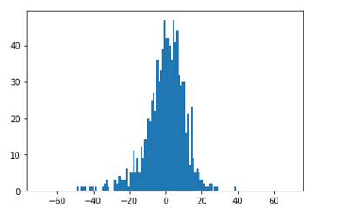
Transformation of Data: Airfare
Data Augmentation:
Time Before Flight
Fluctuation tags
Short term
Mid Term
Long term
Rolling average
% change
Distribution of percentage change

Slide 30
Merging the datasets : Airfare and Car-rental
Joined on :
Date on which flight landed in LAX to date on which car is picked up
Combined features on which machine learning model is trained
Date | Car rental | Airfare | Label
Car Rental Pickup Date | Average Price over last 15 days | Fluctuation Scores, Percent Change | Change
Holiday , Weekend | OUTSIPP | Price Per Mile

Slide 31
Merged Model - Random Forest
Test Classification report
Percentage split of testing data:
Increase: 24%
Decrease: 32%
No Change: 44%
Accuracy on testing data
51.6%
 | Precision | Recall | F1-score
Decrease | 0.53 | 0.16 | 0.25
Increase | 0.47 | 0.29 | 0.36
No change | 0.52 | 0.90 | 0.66

Slide 32
Merged Model - Random Forest
Test Classification report
Percentage split of testing data:
Increase: 24%
Decrease: 32%
No Change: 44%
Accuracy on testing data
51.6%
 | Precision | Recall | F1-score
Decrease | 0.53 | 0.16 | 0.25
Increase | 0.47 | 0.29 | 0.36
No change | 0.52 | 0.90 | 0.66

Slide 33
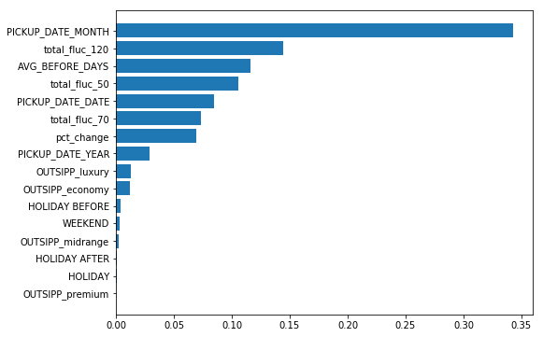
Merged Model - Feature Importance

Slide 34
24th April, 2020
26th April, 2020
15th April, 2020
6th March, 2020
25th March, 2020

Slide 35
Models tried
Random Forest
KNN
SVM
Logistic Regression
Neural Networks

Slide 36
Inferences
Model Accuracy improves by adding airfare features
Depends on airfare fluctuations (short, mid, long)
Further enriched features will help improve accuracy

Slide 37
Prospective Future Work
Aggregate by Regions/Cities
Different time before rental
Enhanced Feature Engineering
Vector Autoregression Model (VAR)

Slide 38


Challenges
High volume data
Exploration of domain specific knowledge
Solutions:
Aggregations
Jupyter to snowflake connector
Consult the QL2 team
Airfare | Car Rental
92 million rows | 8.5 billion rows

Slide 39
Meeting Schedules
Client Interaction
Project Advisor sync up
Team Meeting, Status check, Feedback, Working session
Zoom Call : Weekly
Emails : AdHoc
In-Person/Zoom : Weekly
Emails : AdHoc
In person/Zoom Call: Alternate days

Slide 40
Questions and Feedback

